Slide 1

Basic Electrical Engineering
By
Dr. G. Ramesh

Slide 2
Syllabus
Unit – I: Introduction to Electrical Engineering
Ohm’s Law, Basic circuit components, Kirchhoff’s Laws. Types of sources, Source transformation, V- I relationship for passive elements. Series parallel circuits, Star - delta and delta - star transformation, mesh and nodal analysis. Network theorems-superposition, thevenin’s theorem and maximum power transfer theorem, Simple problems.
Unit – II: Fundamentals of Single phase and three phase AC circuits
Principle of AC voltage, waveforms & basic definitions. R.M.S. and average values of alternative currents and voltage, Form factor and Peak factor. Phasor representation of alternating quantities, the J operator and phasor algebra. Analysis of ac circuits with single basic network element, Single phase series circuits. Faraday’s laws of electromagnetic induction, concept of self and mutual inductances.

Slide 3
Unit – III: D.C Machines:
Principle of operation of D.C generators, Types of D.C generators, Types of D.C motors, Torque equation, Losses and efficiency calculation in D.C Generators and D.C motors.
Unit – IV: Single Phase Transformers
Principle of operation, Constructional Details, Ideal Transformer and Practical Transformer, equivalent circuit, Losses, OC and SC Test, Efficiency and Regulation Calculations, Elementary treatment & Simple problems.

Slide 4
Unit – V: Three phase Circuits and three phase induction motors
Three phase circuits – phase sequence, Star and delta connection, Relation between line and phase voltages and currents in a balanced system.
Three phase induction motor: Principle of operation, Construction, Types, Problems on slip, rotor frequency, rotor emf and torque.
Unit – VI: Basic Instruments
Introduction, classification of instruments, Operating principles, Essential features of measuring instruments, Permanent Magnet Moving coil (PMMC) instruments, Moving Iron (MI) instruments, Extension of Ammeter and voltmeter ranges.

Slide 5
Text Books:
Basic Electrical Engineering - T.K.Nagsarkar and M.S.Sukhja -Oxford University Press, 2nd edition.
Basic electrical Engineering – M.S.Naidu and S.Kamakshiah – TataMcGraw-Hill, 2005 edition.
References:
Theory and problems of Basic electrical Engineering- D.P.Kotahari & L.J.Nagrath PHI.
Principles of Electrical Engineering - V.K.Mehta, S.Chand Publications.2nd edition

Slide 6
Basic Electrical Engineering UNIT-I: Introduction of Electrical Engineering
By
Dr. G. Ramesh

Slide 7
Unit-I: Syllabus
Ohm’s Law, Basic circuit components, Kirchhoff’s Laws. Types of sources, Source transformation, V- I relationship for passive elements. Series parallel circuits, Star - delta and delta-star transformation, mesh and nodal analysis. Network theorems-superposition, thevenin’s theorem and maximum power transfer theorem, Simple problems.

Slide 8
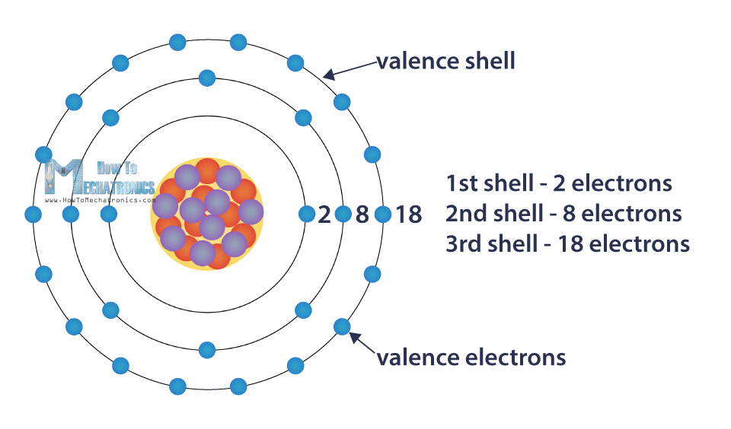
ATOM
Atom is a smallest possible amount of matter, which contains protons , neutrons and electrons
The nucleus (center) of the atom contains the protons (positively charged) and the neutrons (no charge). The outermost regions of the atom are called electron shells and contain the electrons (negatively charged).

Slide 9
Current (I)
Current is defined as the rate of flow of electrons in a conductive or semi conductive material.
The movement of electrons from one end of the material to other end constitutes an electrical current, denoted by I and measured in ampere (A).
It is measured by number of electrons that flow past a point in unit time,

Slide 10
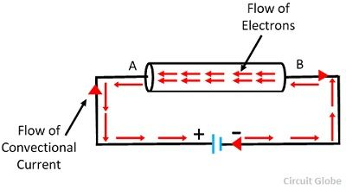
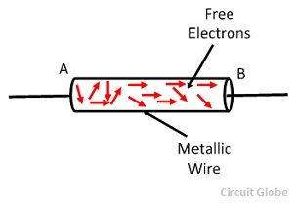
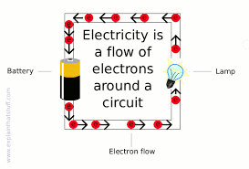

Slide 11
The conventional direction of current flow is opposite to flow of electrons.
One ampere is equal to one coulomb per second.
Pro.1: 50 C of charge flow fast a given point in 4 s. How many amperes of current is flowing?

Slide 12
Voltage (V)
Electrical voltage is defined as electric potential difference between two points of an electric field.
It is denoted by V, it is expressed in terms of energy (W) per unit charge (Q).
Charge (Q) is measured in coulombs (C), one coulomb of charge carried by

Slide 13
One volt is the potential difference between two points when one joule of energy is used to pass one coulomb of charge from one point to other.
Problem 2: if 90 J of energy is available for every 20 C of charge, what is the voltage?

Slide 14
Energy (W)
Electrical Energy is the capacity to do work, and the unit of work or energy is measured in joule ( J ).
Energy may exist many forms such as mechanical, chemical, electrical and so on.
Electrical energy is the product of power multiplied by the length of time it was consumed.

Slide 15
Power (P)
Electrical power is the rate per unit time, at which electrical energy is transferred by an electric circuit.
Electric power is usually produced by electric generators, but can also be supplied by sources such as electric batteries.
The SI unit of power is the watt (W), one joule per second.

Slide 16
When small change in energy is dw and change in time dt, then power equation is
the power is expressed in millwatts (mW), microwatts (µW), kilowatt (KW) and megawatt (MW)

Slide 17
one watt is amount of power generated when one joule of energy consumed in one second.
Thus, the number of joules consumed in one second is always equal to number of watts.
Pro.3: What is the power in watts if energy equals to 100 J is used in 2.5 seconds?
Pro.4: A 100 W fan is working at 230V supply, what is the current and number of electrons passing through the fan in every second.

Slide 18
Ohm’s Law
Ohm's Law deals with the relationship between Voltage, Current and Resistance in any DC electrical circuit at constant temperature.
This relationship states that: the electrical current (I) flowing in an circuit is proportional to the voltage (V) and inversely proportional to the resistance (R).

Slide 19
The resistor's current I is equal to the resistor's voltage V divided by the resistance R
The voltage V is equal to the current I times the resistance R
The resistance R is equal to the voltage V divided by the current I

Slide 20
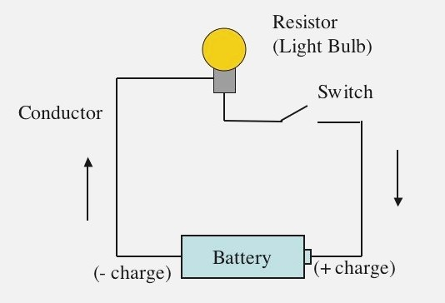
Basic Circuit Components
A basic electrical circuit consists of three main components, a source of voltage, a load, and conductors. In Figure 1, a basic circuit is illustrated. This circuit consists of a battery as the source of electrical energy, a lamp as the electrical load, and two wires as the conductors connecting the battery to the lamp.

Slide 21
Kirchhoff’s Law
Kirchhoff's Circuit Laws allow us to solve complex circuit problems by defining a set of basic network laws and theorems for the voltages and currents around a circuit.
Kirchhoff's Circuit Law is classified in to two types Kirchhoff's Current Law (KCL) and Kirchhoff's Current Law (KVL)

Slide 22
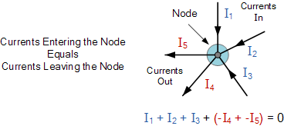
Kirchhoff's Current Law (KCL)
KCL states that the sum of current entering into any node is equal to the sum of the currents leaving that node.
The node may be an interconnection of two or more branches.

Slide 23
Here, the three currents entering the node, I₁, I₂, I₃ are all positive in value and the two currents leaving the node, I₄ and I₅ are negative in value.
Then this means we can also rewrite the equation as
I₁ + I₂ + I₃ – I₄ – I₅ = 0
We can use Kirchhoff’s current law when analyzing parallel circuits.

Slide 24
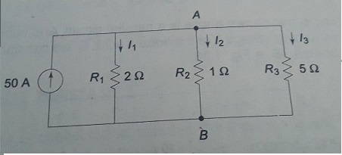
Pro.5: Determine the current and power in all resistors in the circuits shown in figures.

Slide 25
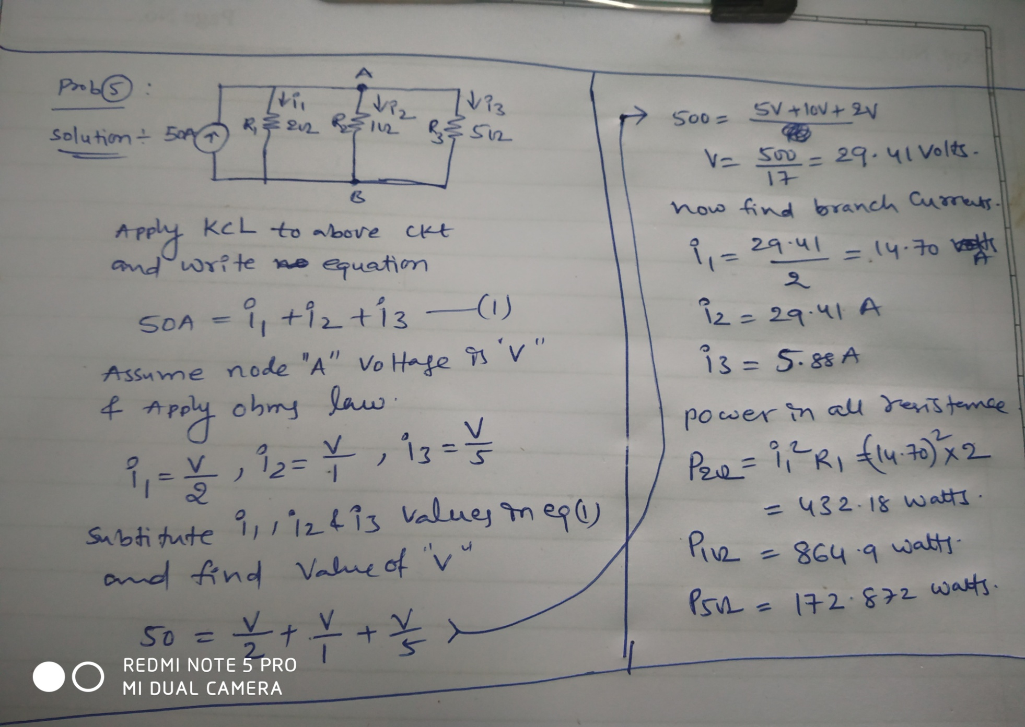

Slide 26
Kirchhoff's Voltage Law (KVL)
KVL, states that “in any closed loop network, the total voltage around the loop is equal to the sum of all the voltage drops within the same loop” which is also equal to zero.
In other words the algebraic sum of all voltages within the loop must be equal to zero.
When current passes through a resistor, there is a loss of energy and voltage drop across the resistor.

Slide 27
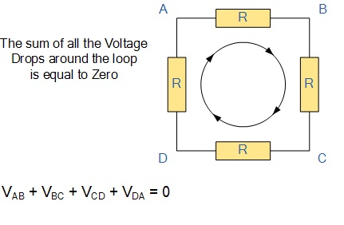
Starting at any point in the loop continue in the same direction noting the direction of all the voltage drops, either positive or negative, and returning back to the same starting point. We can use KVL when analyzing series circuits.

Slide 28
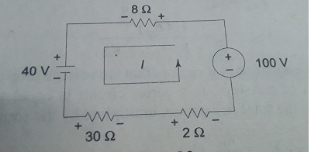
Pro.6: What is the current in the circuit shown in figure?. Determine the voltage across each resistor.

Slide 29
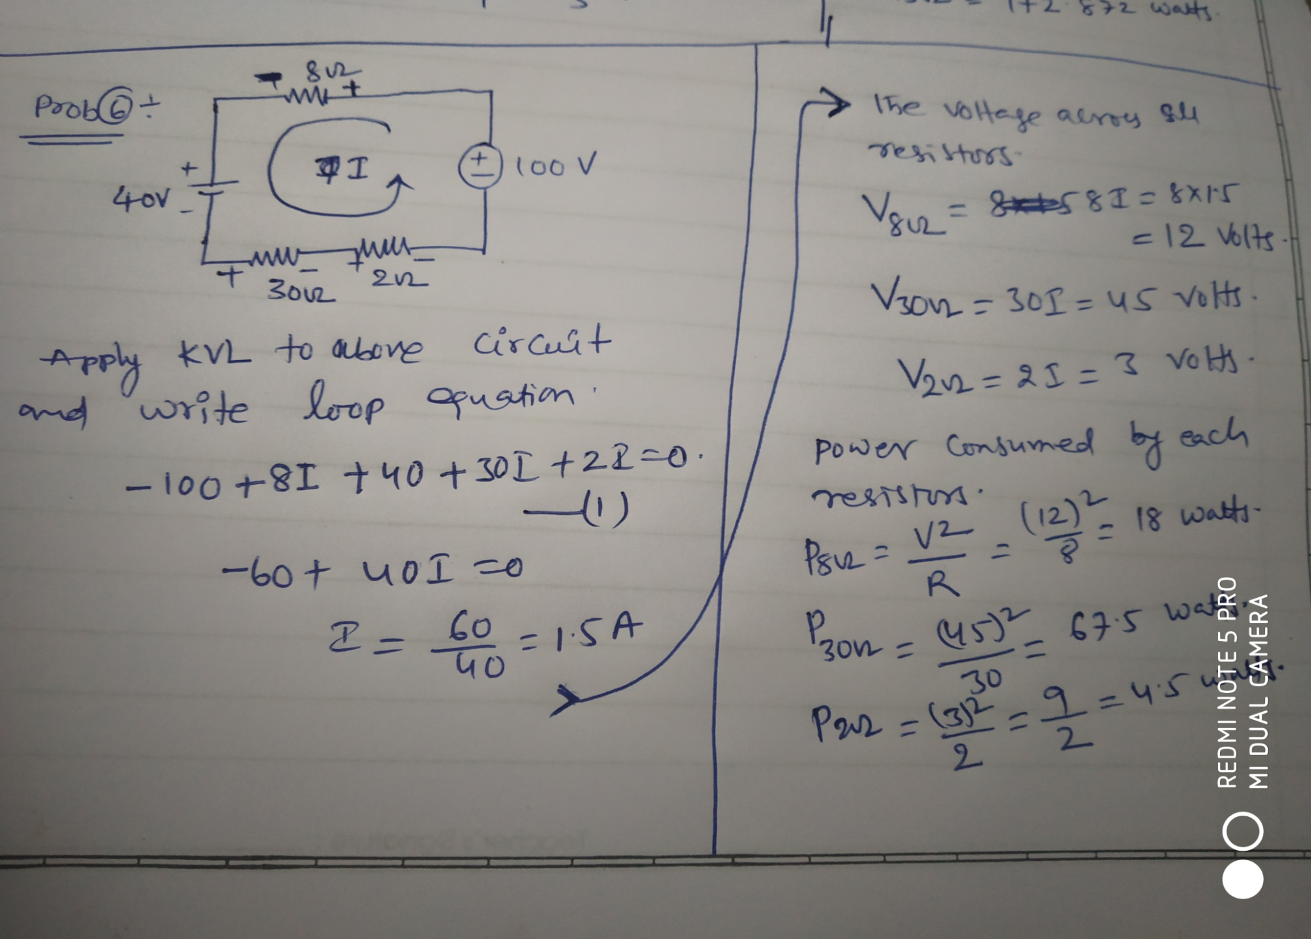

Slide 30
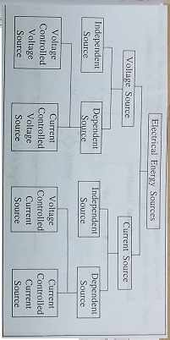
Type of Sources

Slide 31
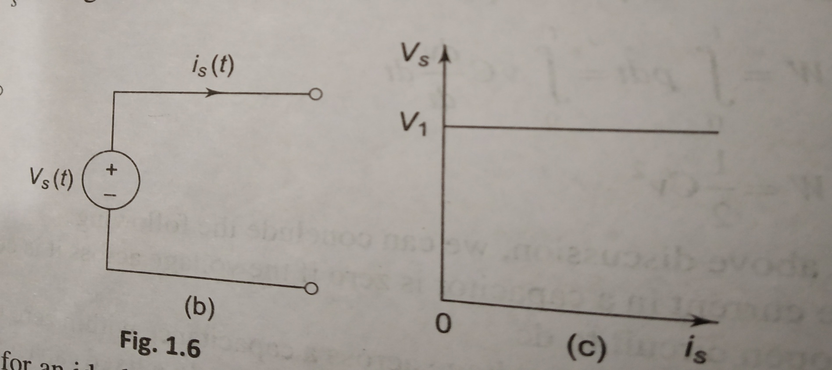
Independent Voltage Source
According to voltage–current characteristics, Independent voltage source is expressed in ideal as well as practical case.
Ideal case: An ideal voltage source is a two terminal element in which the voltage V is completely independent of the current I.

Slide 32
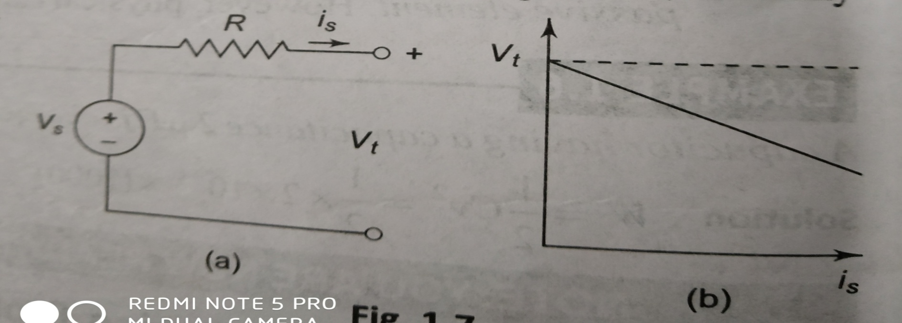
In practical voltage sources, the internal resistance is represented in series with the source, where voltage across the terminals falls as the current through it increases.

Slide 33
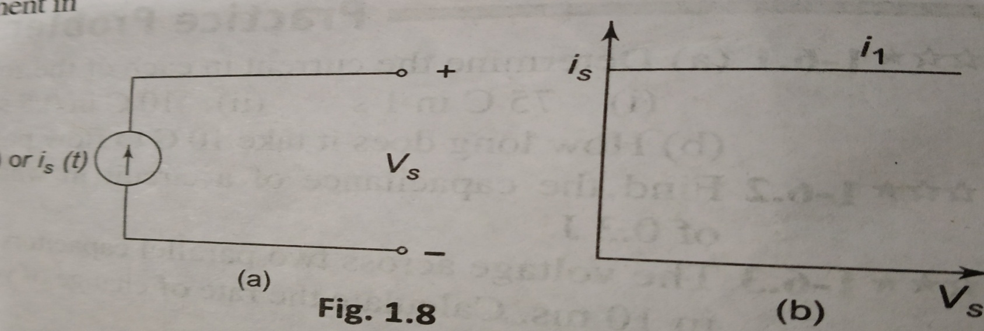
Independent Current Source
According to voltage–current characteristics, Independent current source is expressed in ideal as well as practical case.
An ideal constant source is a two-terminal element in which the current I is completely independent of the voltage V across it terminals.

Slide 34
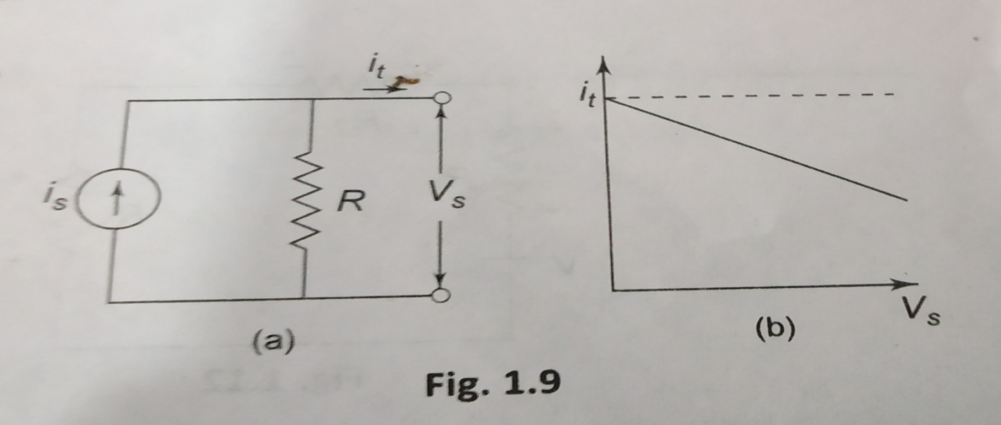
In practical current sources, the resistance is in parallel with the source, where magnitude of current falls as the voltage across its terminals increases.

Slide 35
Source Transformation
Performing a source transformation consists of using Ohm's law to take an existing voltage source in series with a resistance, and replacing it with a current source in parallel with the same resistance, or vice versa.
The transformed sources are considered identical and can be substituted for one another in a circuit.

Slide 36
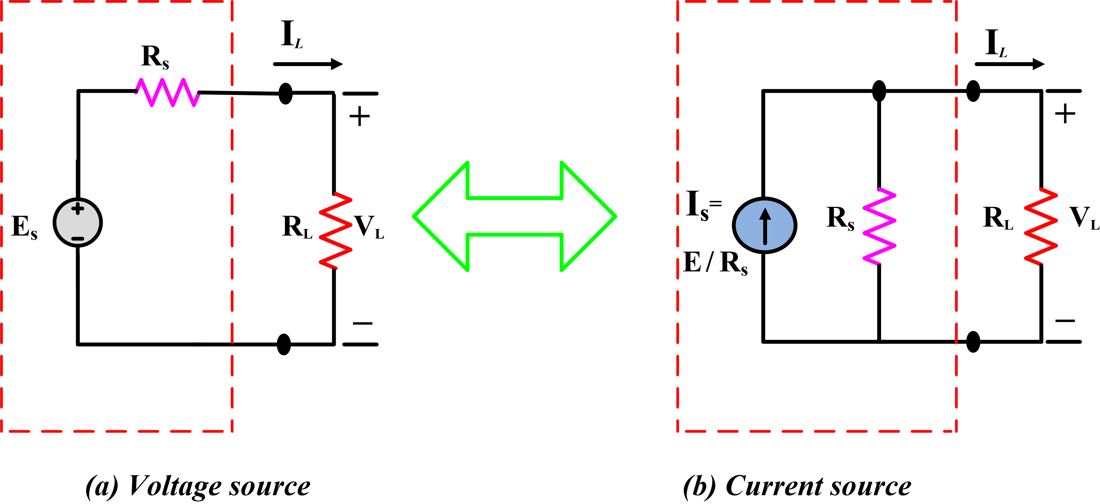
Voltage Source to Current Source:
Pro.7: A voltage source 24 V, is connected in series with the 10 Ώ resistor. Determine the current source and find the current in 5Ώ load resistor.

Slide 37
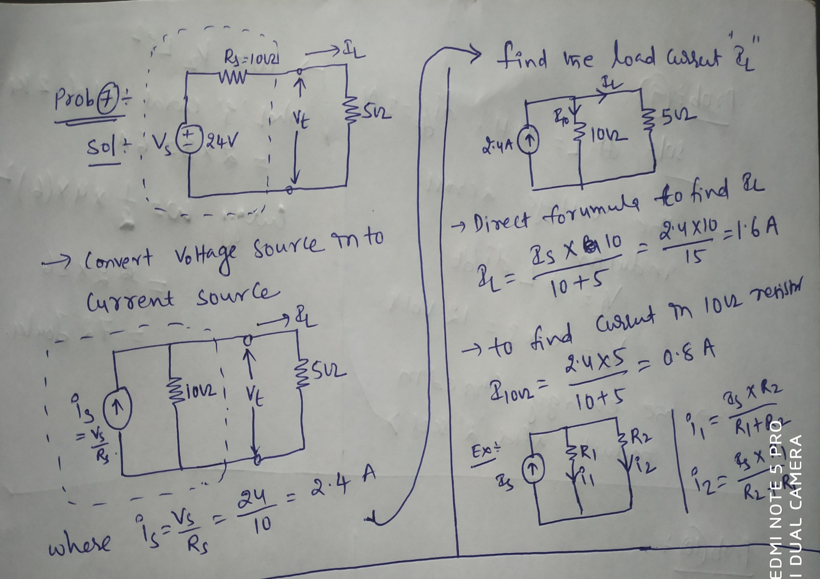

Slide 38
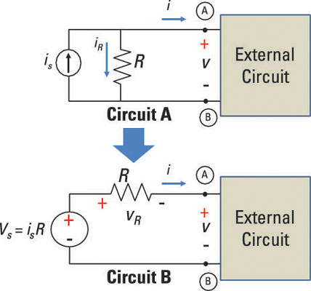
Current Source to Voltage Source:
Pro.8: A Current source 9A, is connected in parallel with the 6 Ώ resistor. Determine the voltage source and find the voltage drop across the 4 Ώ load resistor.

Slide 39
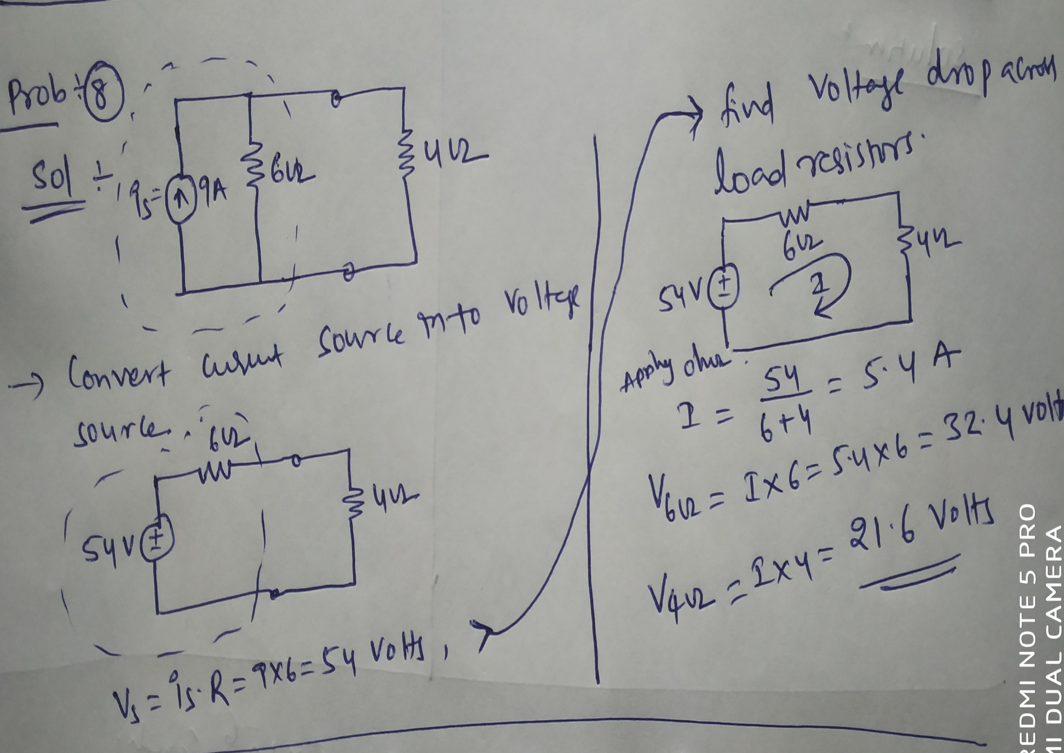

Slide 40
Network Elements
Network elements may be classified into four groups
Active and Passive : Voltage source and current source, resistors, capacitors and inductors.
Unilateral and bilateral : Diodes and Rectifiers
Linear and non-linear: V=IR
Lumped and distributive: resistors and capacitor and inductors and transmission lines.

Slide 41
V-I Relationship for Passive Elements
A passive element is an electrical component that does not generate power, but instead dissipates, stores, and/or releases it.
Passive elements include resistances, capacitors, and coils (also called inductors).

Slide 42
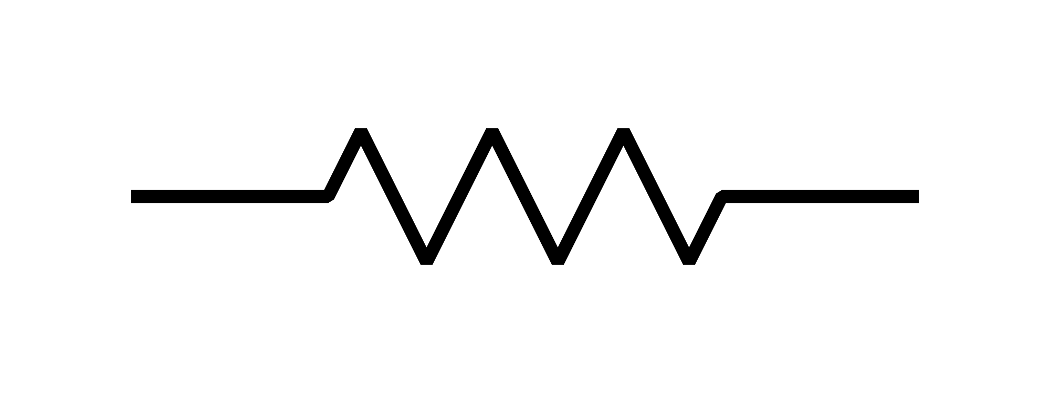
Resistor
The property of a material to restrict the flow of electrons is called resistor, denoted by R.
The unit of resistance is ohm ( ) . Ohm is defined as the resistance offered by material when a current of one ampere flows between two terminals with one volt applied across it.

Slide 43
According to ohms law, the current is inversely proportional to total resistance of the circuit, i.e.
we can write above equation in terms of charge as flows
The power absorbed by the resistor is converted to heat.

Slide 44
The power absorbed by the resistor is given by
Energy lost in a resistance in time t is given by
This loss of energy per unit charge is the drop in potential across the material.

Slide 45
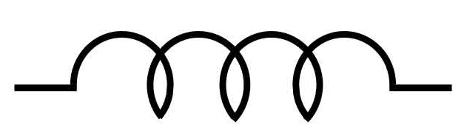
Inductor or Inductance
A wire of certain length, when twisted into a coil becomes a basic inductor, denoted by L.
If current is made to pass through an inductor, an electromagnetic field is formed.
A change in magnitude of the current changes the electromagnetic field.

Slide 46
The unit of inductance is henry H, the inductance is one henry when current through the coil, changing at rate of one ampere per second, induces one volt across the coil.
The current-voltage relation is given by
The power absorbed by the inductor is

Slide 47
The energy stored by the inductor is
The property of inductor
The induced voltage across an inductor is zero if the current through it is constant.
A small change in current within zero time through an inductor gives an infinite voltage across the inductor.

Slide 48
The inductor can store finite amount of energy, even if the voltage across the inductor is zero, and
A pure inductor never dissipates energy, only stores it. That is why it is also called as a non-dissipative passive element.
Pro.9: The current in a 4 H inductor varies at a rate of 3 A/s. Find the voltage across the inductor and energy stored in the magnetic field after 2 seconds.

Slide 49
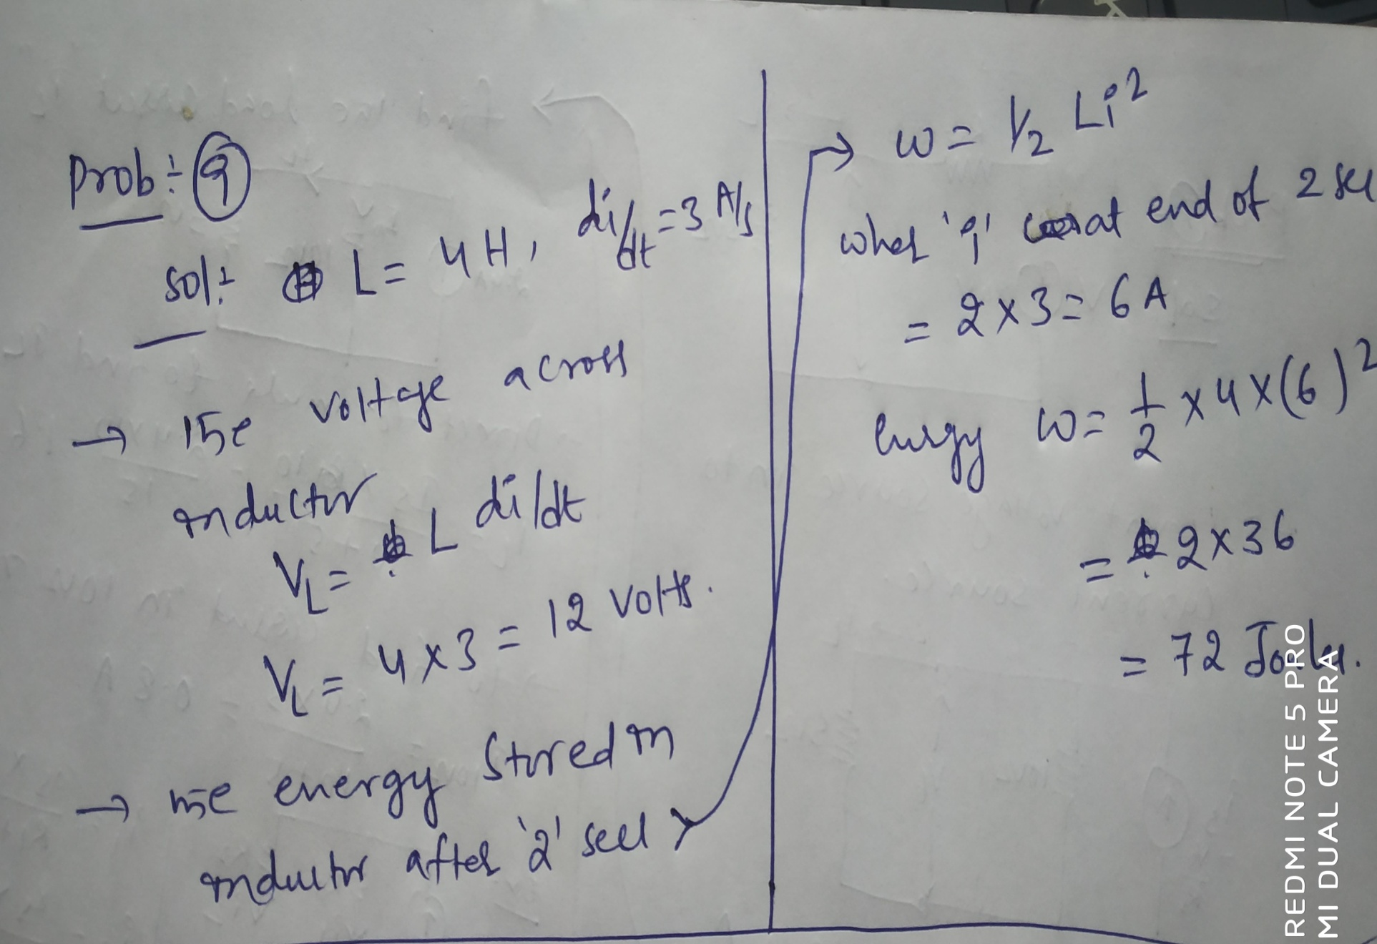

Slide 50
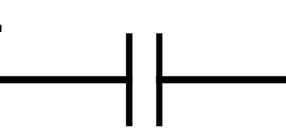
Capacitor or Capacitance
Any two conducting surfaces separated by an insulating medium exhibit the property of capacitor, denoted by C and measured in farad F.
The conducting surfaces are called electrodes, and the insulating medium is called dielectric.
A capacitor stores energy in the form of an electric field that is established by the opposite charges on the two electrodes.

Slide 51
A capacitor is said to have greater capacitance if it can store more charge per unit voltage and the capacitance is given by
The current flowing through the capacitor is

Slide 52
The power absorbed by capacitor is given by
The energy stored by the capacitor is

Slide 53
The property of Capacitor
The current in capacitor is zero if the voltage across it is constant.
A small change in voltage across a capacitor within zero time gives an infinite current through the capacitor.
The capacitor can store finite amount of energy, even if the current through it is zero, and
A pure capacitor never dissipates energy, only stores it. That is why it is also called as a non-dissipative passive element.

Slide 54
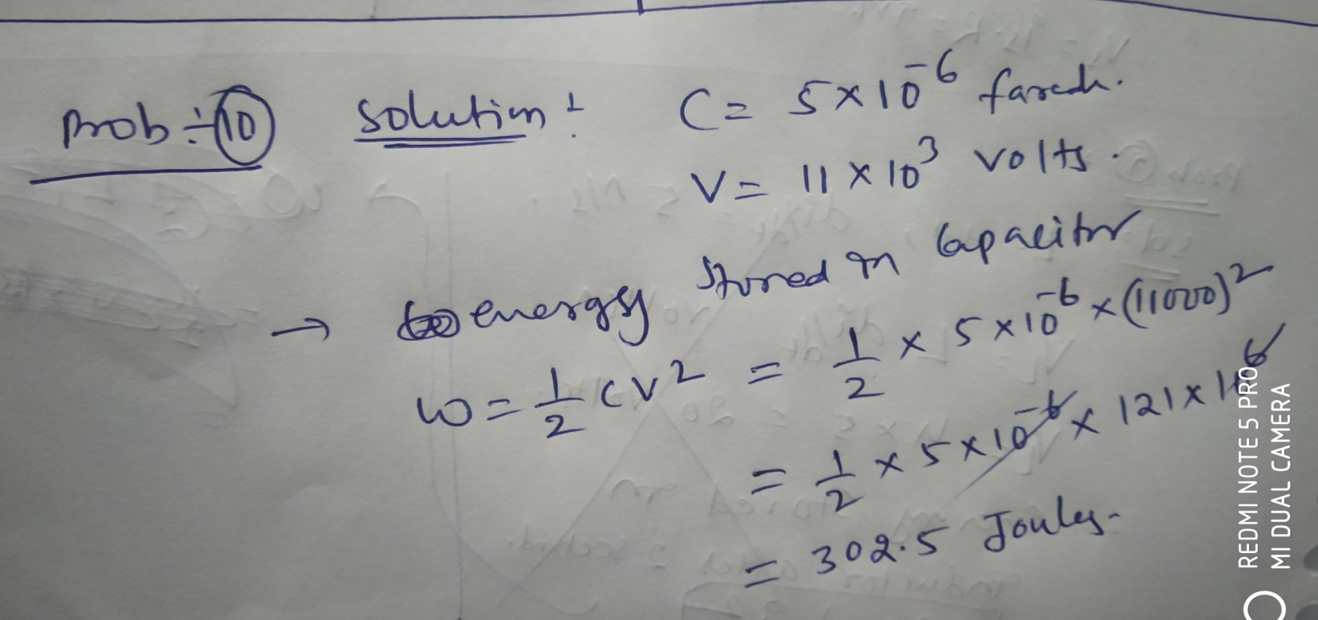
Pro.10: A capacitor having a capacitance 5 micro farad is charged to a voltage 11 KV. Calculate the stored energy in joules.

Slide 55
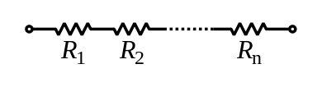
Series Circuits
A series circuit is a circuit in which resistors are arranged in a chain, so the current has only one path to take.
In a series circuit, the current through each of the components is the same, and the voltage across the circuit is the sum of the voltages across each component.
The total resistance of resistors in series is equal to the sum of their individual resistances:

Slide 56
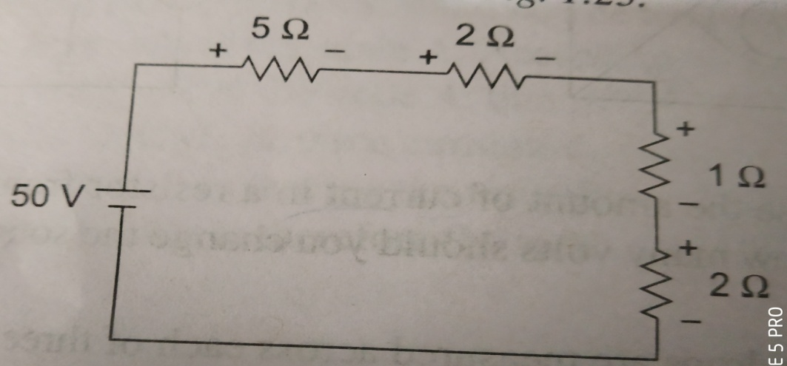
Power in a Series Circuit: The total power supplied by the source in any series resistive circuit is equal to the sum of powers in each resistor in series, i.e.
Determine the total amount of power in the series circuit in given figure

Slide 57


Inductor follow the same law, in that the total inductance of non-coupled inductors in series is equal to the sum of their individual inductances:
Capacitors follow the same law using the reciprocals. The total capacitance of capacitors in series is equal to the reciprocal of the sum of the reciprocals of their individual capacitances:

Slide 58
Parallel Circuits
Parallel circuit is a circuit in which the resistors are arranged with their heads connected together, and their tails connected together.
The current in a parallel circuit breaks up, with some flowing along each parallel branch and re-combining when the branches meet again.
The voltage across each resistor in parallel is the same.

Slide 59
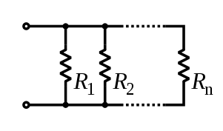
The total resistance of a set of resistors in parallel is found by adding up the reciprocals of the resistance values, and then taking the reciprocal of the total:
Power in a Series Circuit: The total power supplied by the source in any series resistive circuit is equal to the sum of powers in each resistor in series, i.e.

Slide 60
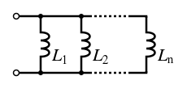

Inductor follow the same law, in that the total inductance of non-coupled inductors in parallel is equal to the reciprocal of the sum of the reciprocals of their individual inductances:
The total capacitance of capacitor in parallel is equal to the sum of their individual capacitances:

Slide 61
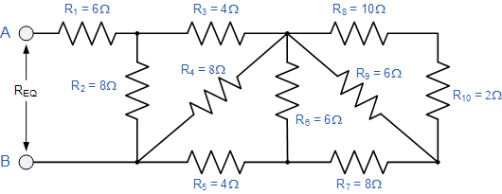
Pro.11: Find the equivalent resistance, R_{EQ} for the following resistor combination circuit.

Slide 62
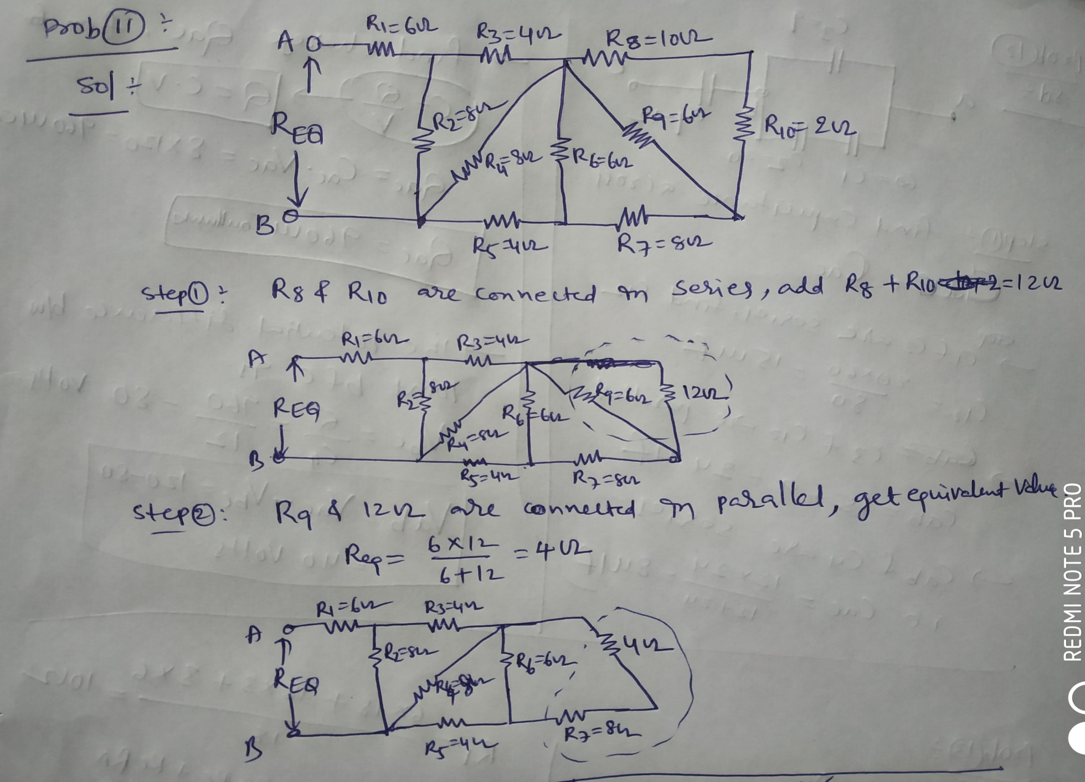

Slide 63
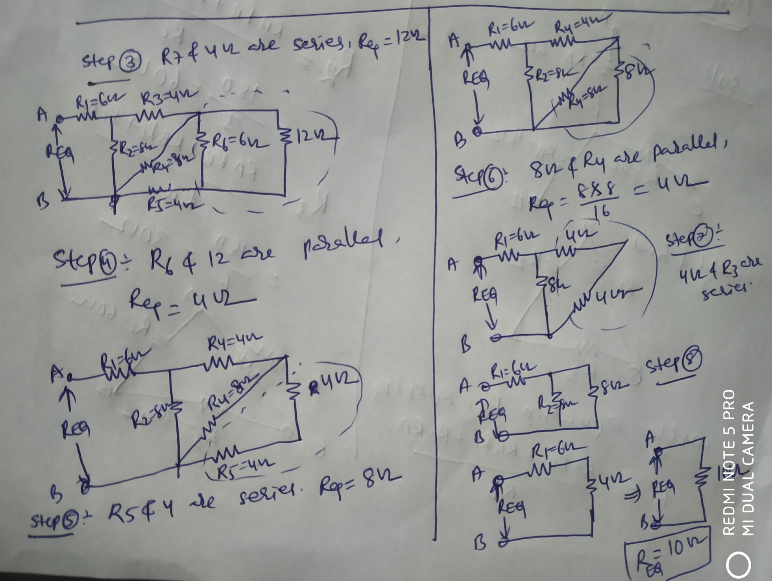

Slide 64
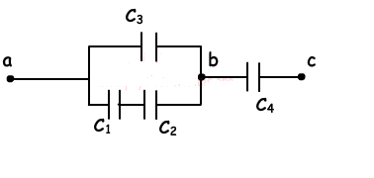
Pro.12: The circuit given below, C1=60µF, C2=20 µF, C3=9 µF and C4=12 µF. If the potential difference between points a and c is Vac= 120V, find voltage across Qac and Vab.

Slide 65
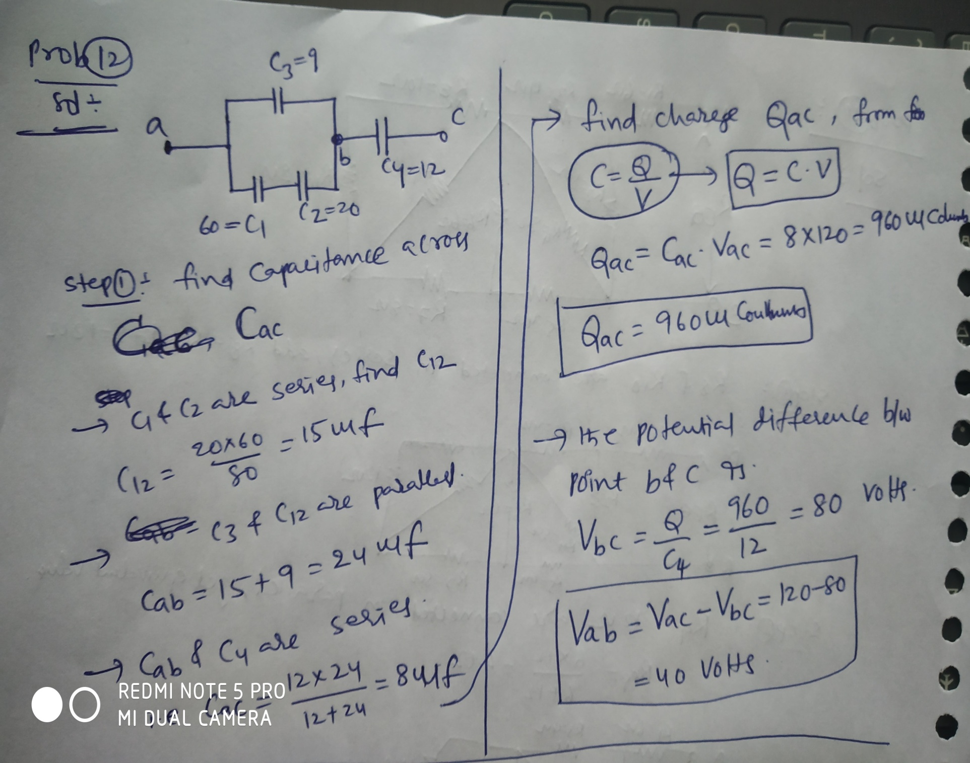

Slide 66
Star to Delta and Delta to Star Transformation
In an electrical network, the connection of three branches can be done in different forms however most commonly used methods are star connection otherwise delta connection.
A star connection can be defined as the three branches of a network can be commonly connected to a mutual point in Y -model.
Similarly, a delta connection can be defined as; the three branches of a network are connected in a closed loop in the delta model.
But, these connections can be changed from one model to another model.

Slide 67
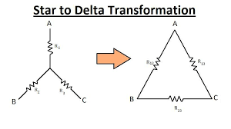
These two conversions are mainly used to make simpler of complex networks.
Star to Delta Transformation
Where the delta connection of resistances are determined by star connection of resistances depends on circuit requirements.

Slide 68
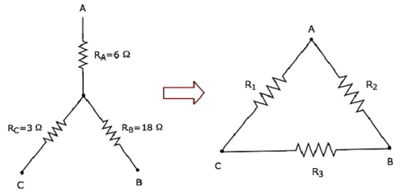
Prob.13: Find equivalent delta connected load R1, R2,and R3 in the given figure.1

Slide 69
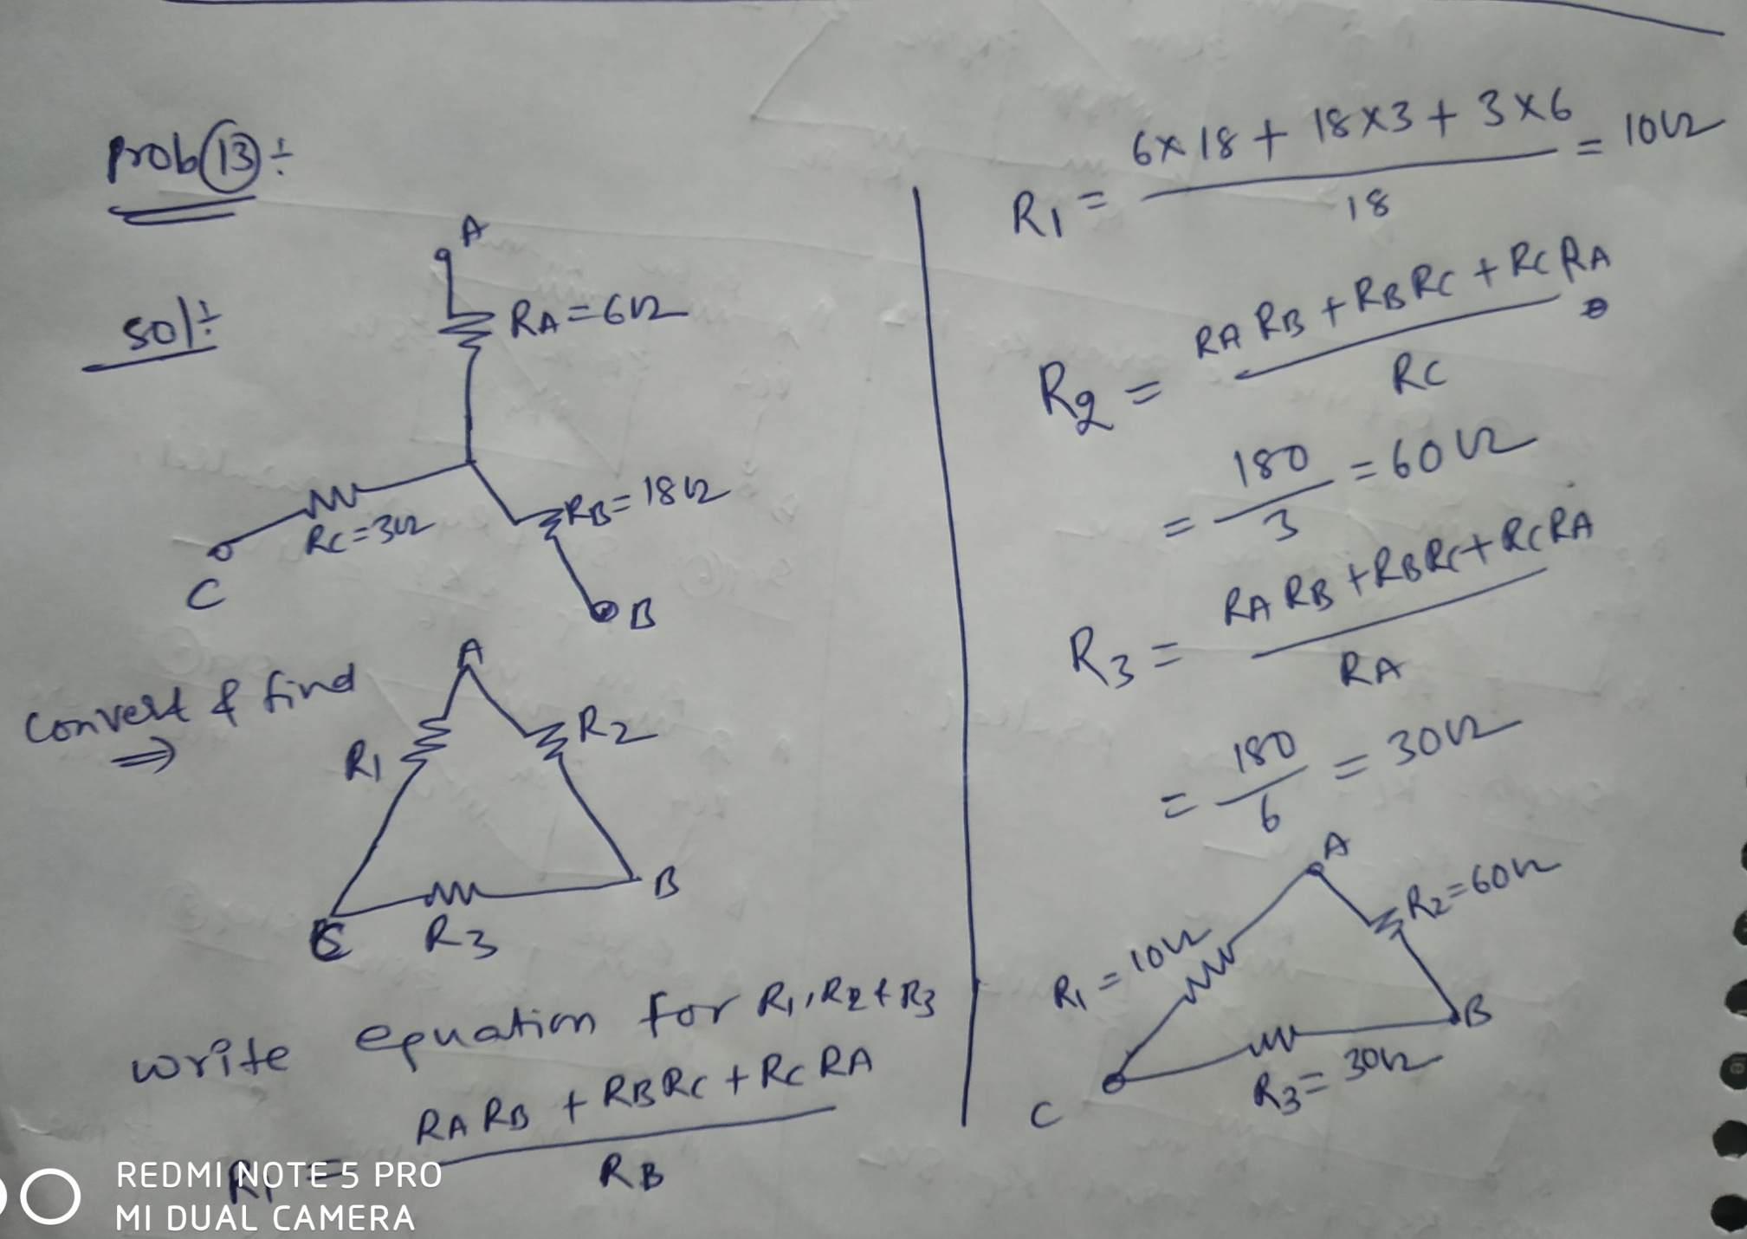

Slide 70
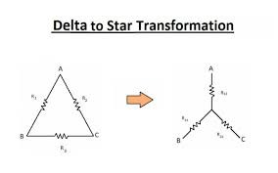
Delta to Star Transformation
The replacement of delta or mesh by equivalent star connection is known as delta – star transformation.

Slide 71
Where the star connection of resistances are determined by delta connection of resistances depends on circuit requirements.

Slide 72
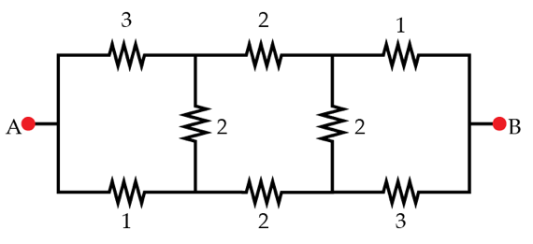
Prob.14: Find equivalent resistance in the given figure

Slide 73
